Slide 1
Full Stack Web Development
Project Proposal
(20%)
STUDY MATE
Danish Mohamed Thodiyil
2403222i
PC02

Slide 2



Declaration of Originality
I am the originator of this work and I have appropriately acknowledged all other original sources used as my references for this work.
I understand that Plagiarism is the act of taking and using the whole or any part of another person’s work, including work generated by AI, and presenting it as my own.
I understand that Plagiarism is an academic offence
and if I am found to have committed or abetted the offence of plagiarism in relation to this submitted work, disciplinary action will be enforced.
Name and Signature of Student:
DANISH MOHAMED THODIYIL

Slide 3
Declaration on the use of Generative AI tools for assignments
Describe how you have used Generative AI tools such as ChatGPT or Dall.E-2 in your assignment.
Show snapshots of the conversations with the AI tool (i.e., the prompts you used and the response you get from the AI tool).

Slide 4
How do you indicate the reference?
The content generated by AI tools are not retrievable except by the user who generated them, so they are considered non-recoverable sources. Although non-recoverable data or quotations in APA Style papers are usually cited as personal communications, with ChatGPT-generated text there is no person communicating. Quoting text from ChatGPT chat is therefore more like sharing the output of an algorithm, with a reference list entry and the corresponding in-text citation.
According to the official APA Style site, ChatGPT references should be cited as:
E.g. OpenAI. (2023). ChatGPT (Sep 25 version) [Large language model].
https://chat.openai.com/chat
Important Note:
Do not copy answers produced by the AI tool in totality as it is considered as plagiarism.
Do not rely on any information produced by the AI tool blindly. You should always verify the answer with other sources. Do not assume that these answers provided by the AI tool are correct.
To achieve quality outputs from the AI tool, you should provide good prompt that is clear and specific. Be precise and provide context. Avoid asking open-ended questions.

Slide 5
Selected Use Case –
Highlight your selected use case below
Case Study Options (The problem statement serves as a starting point; you can use it as is or adapt it based on your users' specific needs.):
Campus Event Management System
Problem Statement: Students often miss out on campus events due to scattered announcements, lack of reminders, and complicated registration processes, leading to low participation and poor event visibility.
Library Book Finder & Reservation System
Problem Statement: Students waste time searching for books in the library without knowing their availability, resulting in frustration and missed opportunities to access learning resources.
Peer-to-Peer Learning / Tutor Finder
Problem Statement: Students often need academic help but struggle to find peers with the right expertise, leading to missed learning opportunities and uneven access to support.
Internship & Job Portal for Students
Problem Statement: Students often struggle to find internships and job opportunities relevant to their courses, as postings are scattered across multiple platforms with no campus-specific matching.

Slide 6
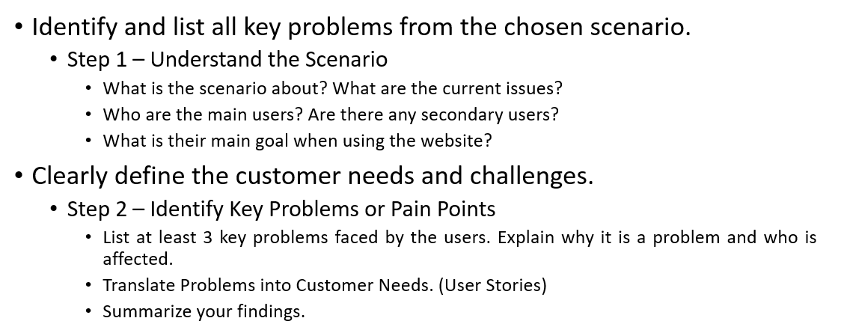
Problem Definition/Customer Needs (4%)

Slide 7
Problem Definition/Customer Needs (4%)
Students often struggle to find someone who can help them in academics. Some student may need a quick assistance in certain topic of the subject while some others may need a group to revise or prepare for exams. Currently school doesn't have any such facility for student to rely on.
StudyMate can help connect students who want help and those who are ready to help.
Students will be able to search by subject; create new study group and join in existing groups.

Slide 8
Problem Definition/Customer Needs (4%)
Students face difficulties when trying to find someone who can help them with the subject, student often rely on their small friend group or internet to understand difficult topics but instead waste their time without understanding anything.
Students who know a subject very well and is willing to teach others; don’t know who need their help. They don’t have a proper way to connect and arrange meeting with others.
There is no platform that connect the students who need help and students who are willing to help. The WhatsApp group or the telegram group may be helpful at first but later become messy and hard to manage.

Slide 9
Problem Definition/Customer Needs (4%)
User Stories
-As a student who needs help on studies, I need to find peers who excel in the module that I have issue understanding with
-As a student, I need to join or create peer group for combine and collaborative learning for preparation over projects and exams
-As a student exceling in certain module, I need to help other peers and improve skills

Slide 10
Problem Definition/Customer Needs (4%)
Summary
Students don’t have a medium to connect, to realize their weakness and work on that with their peers those who excel in the module, StudyMate fills this gaps by giving a way to showcase their excellence and find help on their weakness by helping join study group, find tutor etc.

Slide 11
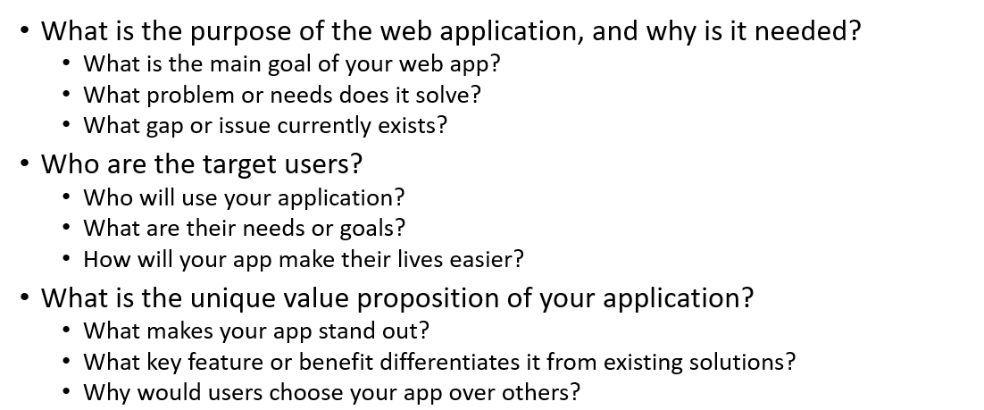
Project Objectives (3%)

Slide 12
Project Objectives (3%)
The main objective of StudyMate is to serve a medium of connection for peer-to-peer learning.
This helps students to find study groups and tutors based on the subject.
StudyMate fills this gaps by giving a way to showcase students excellence and find help on their weakness by helping join study group, and find tutors giving them an academical support.

Slide 13
Project Objectives (3%)
Main users: students who are weak in specific modules and student who excel in specific module and are willing to help others.
User goals: to get quick help on academics, relevant and syllabus- based help, to help others voluntarily there by increasing their soft skills and also the knowledge on that module.
Easier to find help on based on the module and will be syllabus based, helps build study groups and communities over school.

Slide 14
Project Objectives (3%)
Unique value proposition
Unlike other platforms StudyMate concentrate on peer-to-peer learning. It is student centered platform where only the Temasek poly student have access to this website. Here the students are the learners and tutors, hence providing a friendly safe academic environment where everyone can study and grow together.
The features like search tutors, study group based on subject make it easy for students to find what they are searching for. Additionally, any student can create their own study group, and this develop leadership, organization and decision-making skill of that student.
And the point and badge system motivate students to actively participate and make the website experience more engaging, thus creating a little competitive feeling inside students to earn more points.

Slide 15
Proposed Features (3%)
Outline the planned functionalities in detail.
Feature Name | Description / Purpose | User Actions / What It Does | Expected Outcome / Display | Notes / Future Plans
User Login & Signup | Allow users to create accounts and log in. | Users can sign up with their school email and password. | Users see a home page | Will later connect to a database for real login.
Search By Subject | Allow user find tutor or study group by subject. | Users can type the subject or select it from “popular subject” section of the homepage | Display the result page with two tabs, one for finding tutors and the other of finding the study group. | Add filters in future.
Popular subject section | Show the popular subject based on the number of users liked to them. | Users can view this section in the homepage | Clicking on to any of these subject will show same result as a search,; it will help you to filter tutor and group by subject. | Auto update the popularity count
Study group functionalities | Allow user to create and join study groups. | User can either create their own study group or request to join an existing r study group | User can click on the join button to send request to the admin. | In future, create a limited time group chats.
Notification system | Allow user to see the status of their requests like request to join group or tutor help request etc | User can click on the bell icon on the home page to see all the notification | It will display all the notification about the status of the requests | Future, implement push notification

Slide 16
Proposed Features (3%)
Outline the planned functionalities in detail.
Feature Name | Description / Purpose | User Actions / What It Does | Expected Outcome / Display | Notes / Future Plans
Tutor Requesting | Allow users to request for a tutor | Users can send a request including the details of subject, specific topic, and time. Tutor can either accept or reject. | A status notification | In future, add a chat feature.
Tutor profile setup | Tutor can specify the subject they can help other with, and their available time. | During sign in users can select the subject and time slots | User profile will have some kind od badge or tag, indicating they are tutors. | In future, have a reward system or point system for tutors, who are volunteering to help.
Points and badges (Additional feature) | Introduce a point and badge system to encourage more students to actively participate. | Users earn points when they offers to tutor others or join in a study group. Badges are automatically rewarded by the system when certain conditions are met. | Users can see their points and badges on their profile. | In future, plan to expand into a full rewarding system with academic recognition.

Slide 17
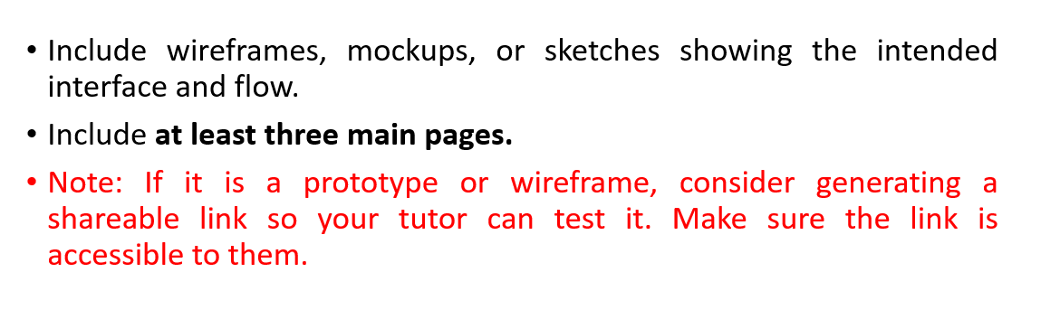
Wireframe (5%)
Design Mode | https://www.figma.com/design/mVan8uqDlCnjZ5mHBP6iBM/FWEB-LOWIFI?node-id=0-1&t=A89BDTVBqosqpbeT-1

Slide 18
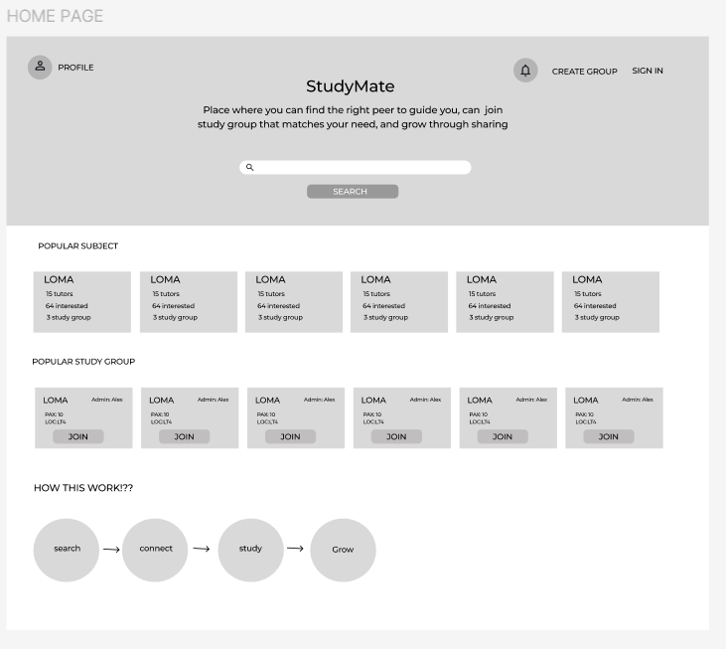
Wireframe (5%)
This is the homepage of my website, here the user can search tutors and study group by subject. And the popular subjects and popular study groups are also displayed.
User can access user profile, notification and can also create study group
Notification contain information like whether the join request to the group is accepted or not, status of tutor help request etc

Slide 19
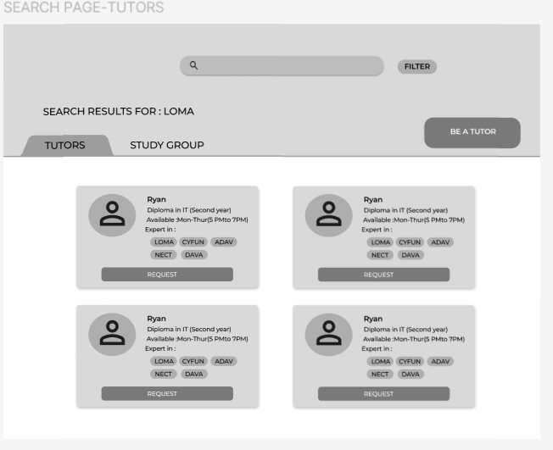
Wireframe (5%)
This page is the search result page, here the user can see two tabs called tutor and study group. This improve the user experience while browsing.
When clicked on the tutor tab user can view all available tutors in that subjects, user can send request for their help.

Slide 20
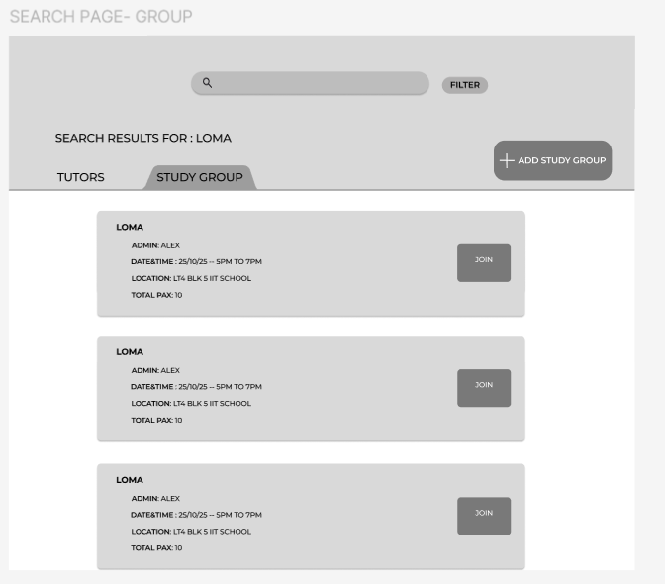
Wireframe (5%)
When clicked the study group tab user can view all currently available groups and its details and a button to join the group.
Additionally, there is a add study group button which help user to create a new study group.

Slide 21
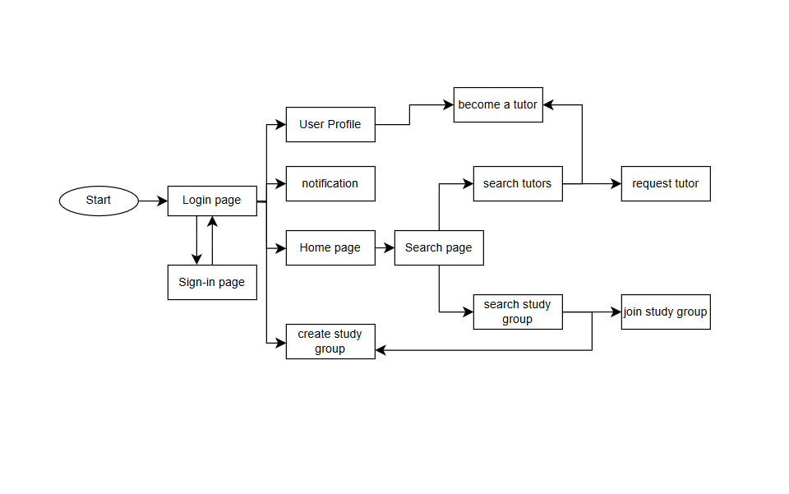
Wireframe (5%)

Slide 22
Data Modeling (5%)
Initial identification of entities in your application.
Include at least four key data models and provide sample attributes for each model.

Slide 23
Data Modeling
Table: User | Description: Store learner/ tutor profile details Usage in App: Used for authentication and displaying details
Attribute | Type | Sample Value | Description
admiNum | String | 2403222i | Admission number of the user. This is used as the unique identifier. This is the primary key
name | String | dansih | Full name of the user
email | String | 2403222I@student.tp.edu.sg | Campus email address of the user for authentication
course | String | Diploma in IT | Course details of the user
Year | int | 2 | More details about the user
subject | Array | [“loma”, ”adav”, ”nect”, ”dava”] | List of subject the user wants to learn or tutor
availabilty | String | Mon-thurs, 5 pm to 7 pm | Users available time for tutoring
createdAt | Date | 2025-09-1 00:00:00 | Timestamp when the user profile was created

Slide 24
Data Modeling
Table: Subject | Description: Stores available subjects for peer learning and categorizes them for searching. Usage in App: Displayed on the homepage as Popular Subjects and used as a filter
Attribute | Type | Sample Value | Description
subjectId | string | S101 | Unique identifier for each subject
name | string | Loma | Name of the subject, it is used for displaying, and searching
interested | Integer | 12 | Number of users who are linked to this subject.

Slide 25
Data Modeling
Table: StudyGroup | Description: Stores study group information, including meeting details and participants. Usage in App: Display group details
Attribute | Type | Sample Value | Description
groupId | String | G101 | Unique identifier for each study group
name | string | Loma basics | Name of the study group to display
subject | string | loma | The subject associated with this group
admin | string | 2403222i | Id(admin num) of the user who created this group
location | string | Lt4, blk 5 hss | Location where the group will meet
dateTime | string | 2025-10-5 5 pm to 7pm | Meeting date and time
totalpax | Int | 10 | Total number of users in this group
createdAt | Date | 2025-09-7 08:09:00 | Timestamp when the group was created

Slide 26
Data Modeling
Table: GroupJoinRequest | Description: Tracks user requests to join study groups and their approval status. Usage in App: Used to manage membership workflows and prevent duplicate requests.
Attribute | Type | Sample Value | Description
requestId | String | R101 | Unique identifier for each join request.
groupId | String | G101 | ID of the study group the user wants to join.
userId | String | 2403222i | ID(admin num) of the user making the request.
status | String | pending | Status of the request (pending / approved / rejected).
createdAt | Date | 2025-09-7 08:09:00 | Timestamp when the request was created
processedAt | Date | 2025-09-7 15:09:00 | Timestamp when the request was either approved or rejected

Slide 27
Data Modeling
Table: PointsAndBadge | Description: Stores points, badges of each user Usage in App: Used to display badges and points on user profiles and motivate students to engage on the website.
Attribute | Type | Sample Value | Description
pointId | String | P101 | Unique identifier for each record of points earned by user.
userId | String | 2403222i | ID(admin num) of the user, to display on the user profile
points | int | 45 | Total points earned by the user
badges | Array[Strings] | [“Top helper”, “group leader”] | List of badges earned by user
lastUpdated | Date | 2025-09-7 08:09:00 | Timestamp of the last update

Slide 28
The End

